Slide 1
Sourcing RFQ with Ariba Supplier Guide
September 20, 2018

Slide 2
About this guide
Primary Audience:
  Adient suppliers
Scope:
  Global procurement for direct goods
Objectives:
  Register for Ariba Cloud Commerce
  Navigate Ariba Sourcing screens
  Submit prerequisites
  Submit RFQ bid with Ariba

Slide 3

Getting started in Ariba
Ariba Sourcing introduction
Accessing Ariba
Sourcing dashboard
Notes:
Enter title of topic and bulleted list of subtopics
Optional: Replace picture with one that is relevant to the topic

Slide 4
Ariba Sourcing introduction
Ariba Sourcing is used to facilitate the request for quotation (RFQ) process.
Adient buyers will setup a sourcing event with a set timeframe within SAP Ariba.
Suppliers who will participate in RFQ events register first with the Ariba Commerce Cloud.
Suppliers participate through submitting Ariba on-line price quotes to Adient.
Benefits both Adient buyers and suppliers to have all RFQ event activities, documents and messages centrally managed in one on-line tool vs. local RFQ copies attached in Email.

Slide 5
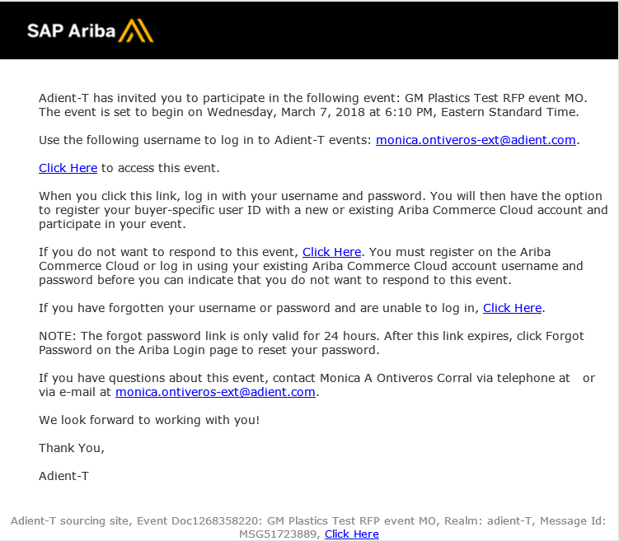
How will you learn of a RFQ event?
To participate in an event, you must first be invited to one. If you are invited, you will receive an email notification at the email address you have on file with Adient. An invitation from an Adient buyer will include:
Event start date and time
Username (typically is <Vendor#>-<contact email>)
Event access link
Instructions to register
Link to decline participation
Login assistance link
Event owner name and email

Slide 6
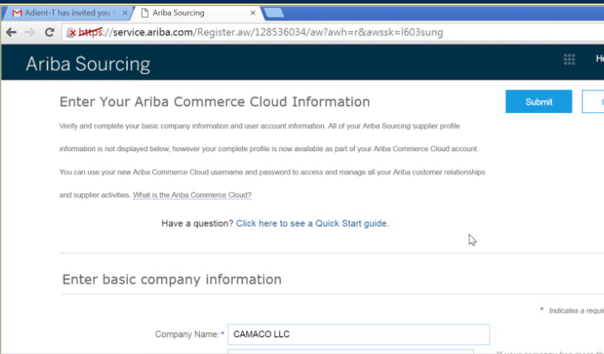
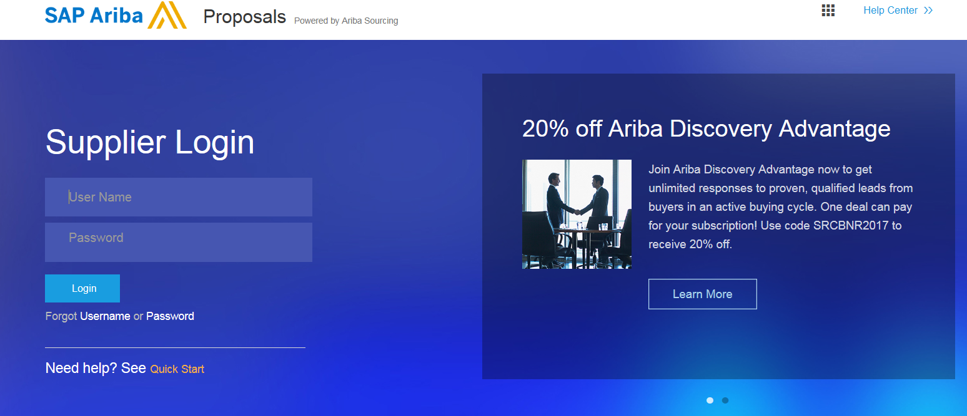
How do you register on Ariba Cloud?
Click on the emailed link to access the event
Click on the link “New Registration” (First time only - skip if already have Ariba account)
Enter the basic information about your organization (mandatory fields marked by *)
You can choose a User Name (email format) different than the Adient generated user id
Select the check box at the bottom of the screen to accept Ariba terms and conditions
Click Submit to complete the registration
You will be redirected to the Adient supplier interface
Login to access the sourcing RFQ events with your user name and password at https://service-2.ariba.com/Sourcing.aw/128527009/aw?awh=r&awssk=MxLVWpJs&dard=1

Slide 7
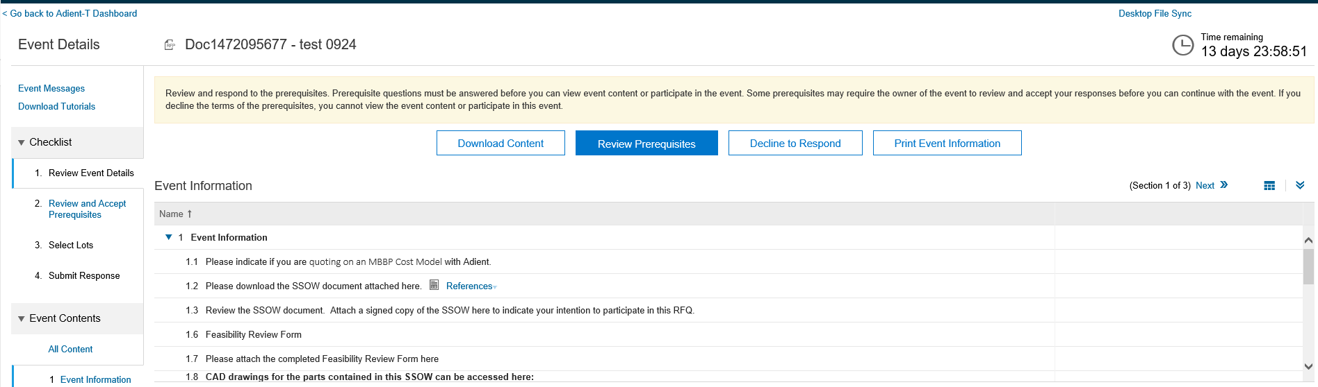
What screen will you see first from the event link?
When you were invited to an event via email, click the event link. Ariba takes you directly into the Event Details screen once you log in. Notice the event countdown clock, many buttons and links to your next actions. You must follow the Checklist of activities in order.
  Go To Dashboard – can click link to see all your Ariba event activities
  Event Messages – will receive Email as well as have notifications here
  Time clock - time remaining to submit your bid into the system
  Event Information – your prerequisite responses on MBBP will determine your next actions within section 2 Terms of Participation and section 3 Pricing. Navigate to other sections here.
  Download Content – click button to download SSOW and RFQ bid form
  Review Prerequisites – link to step 2. Accept prerequisites screen
  Decline to Respond – click, then add reason if cannot participate
  Print Event Information – click if would like to print hard copy

Slide 8
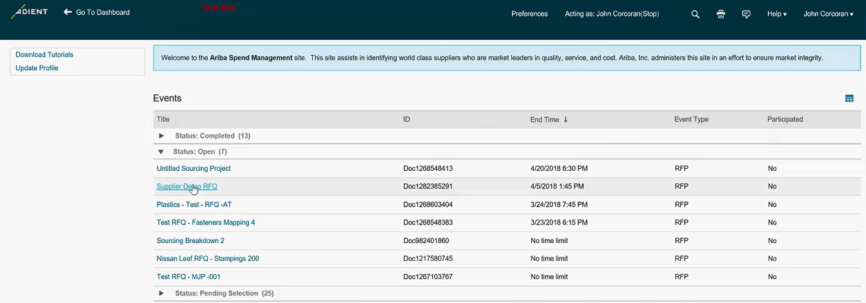
What will you see when logging into Ariba directly from the URL?
  Access Ariba Help
  Access Ariba tutorials and update your profile as needed
If you log into Ariba directly from the saved URL address, you will start at this dashboard screen. Expand the status section(s), click on the event title and the event details will load. You may be invited to multiple events from Adient. Check the Ariba Sourcing dashboard for status on all of your events.
Every event is customized so you may need to provide additional details or check with customer support for event assistance under Help or contact your Adient buyer.

Slide 9

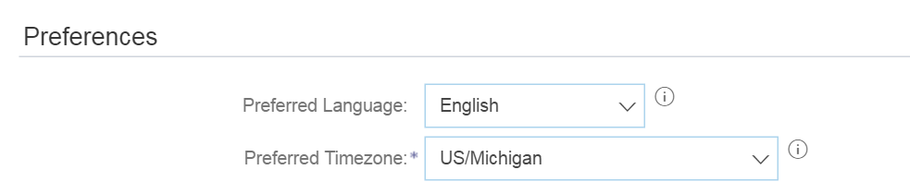
How do you change your user profile?
Click on your User Name drop down at the top right corner
Click on My Account
Go to Preferences
Change Preferred Language and Timezone if needed
Click Save
Note: Language settings are dependent on the language specified in your browser. Ensure your browser language is set to the language you want to view Ariba in. Default currency for RFQ is USD.

Slide 10
Submit prerequisite
Review Event Details
Accept Bidder Agreement
Indicate MBBP buyer
Notes:
Enter title of topic and bulleted list of subtopics
Optional: Replace picture with one that is relevant to the topic

Slide 11
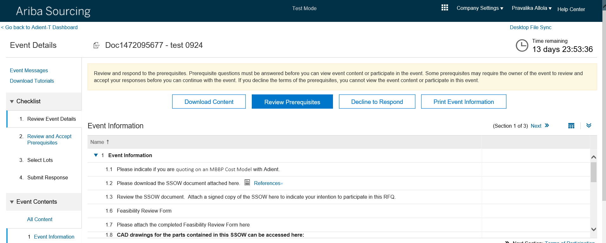
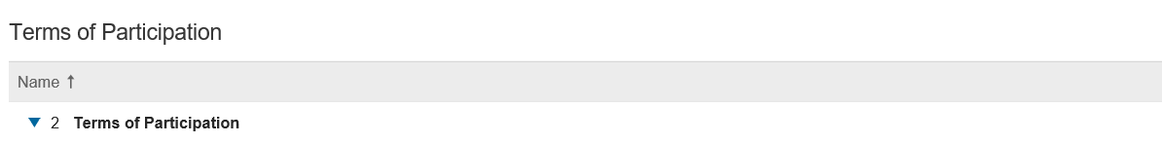
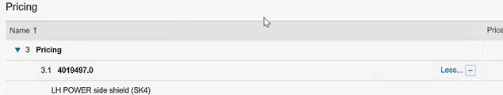
How do you review the event details?
Start at 1. Review Event Details – section 1 Event information and review questions
Click Next to go to section 2 Terms of Participation – no details until answerin prerequisites
Click Next again to go to section 3 Pricing – limited item details at this point
You do not have to take any actions here but now will on Step 2
1
2

Slide 12
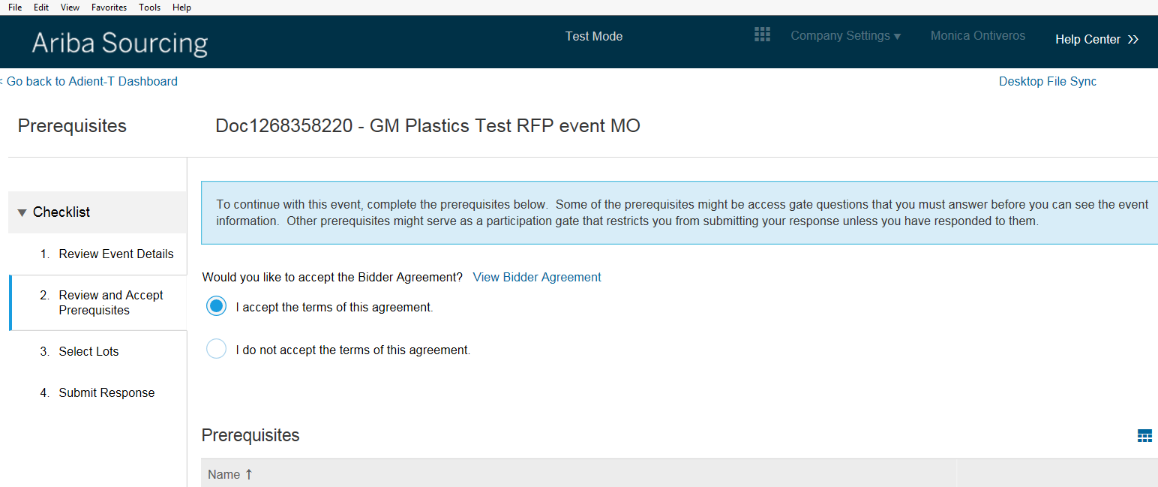
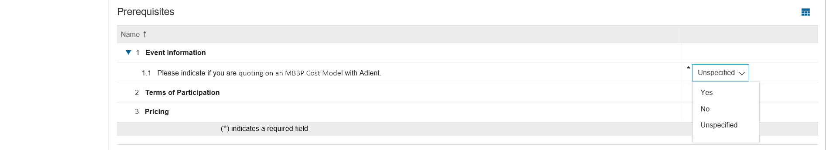
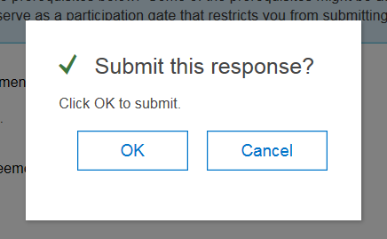
What are your event prerequisite actions?
Step 2. Review and Accept Prerequisite, you must complete these key steps in order to continue.
Accept the terms of the agreement in order to participate.
Indicate if you are a MBBP supplier with Adient by selecting from dropdown list yes or no.
Click OK. You will be asked to confirm your response. Click OK again.
  Click link View Bidder Agreement – asserts that event invitation is not a promise of any business
  MBBP Supplier – select if Material Best Business Practice supplier as will determine which RFQ template you will use in future steps

Slide 13
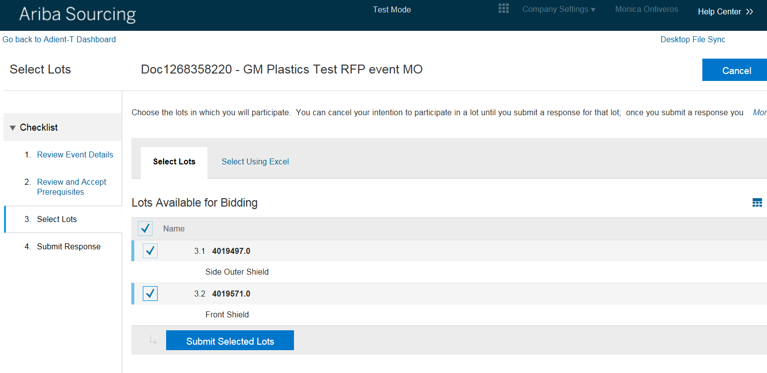
How do you indicate intent to bid on lots?
Step 3. Select Lots.
After you respond to all prerequisites required, you can choose the lots in which you will participate.
The buyer might require you to enter bids on specific items or all lots.
Choose the lots by checking the box next to the lot number or the top box Name for all lots.
Click Submit Selected Lots.
Now the entirety of the event is open for you to submit a bid.
You can return to the Select Lots page later if you want to change your selections before the 14 day event ends.

Slide 14
Submit RFQ
Download event attachments
Complete cost model
Import pricing data
Submit entire RFQ bid
Notes:
Enter title of topic and bulleted list of subtopics
Optional: Replace picture with one that is relevant to the topic

Slide 15
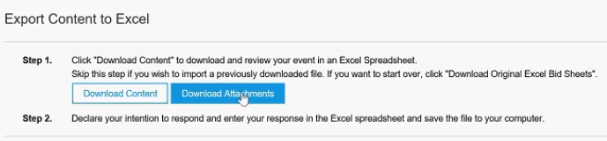
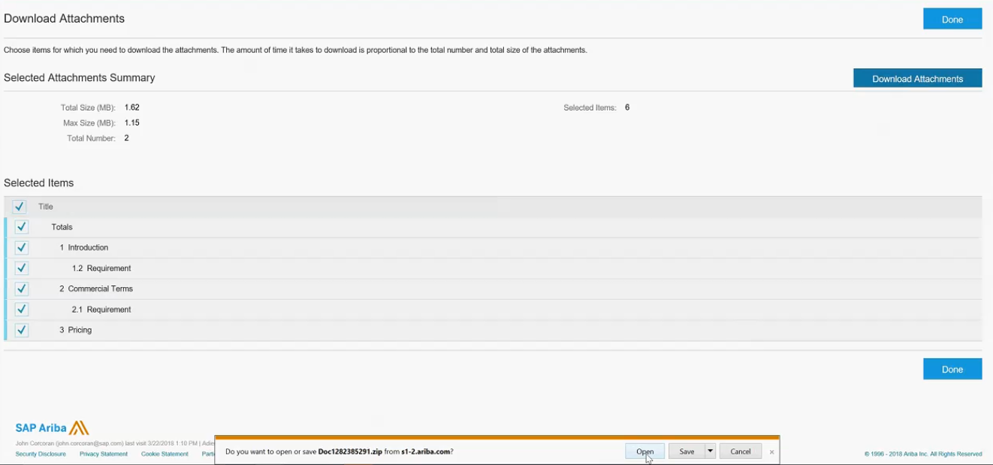
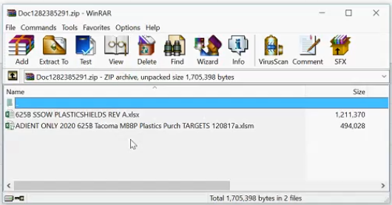
How do you download event attachments?
Click Download Attachments
Mark top Selected Items box
Save .zip folder so complete the documents later, then click Done
1
2
  Two key attachments - SSOW and Excel bid template.
  Minimum of two documents for each event. May be more.
  Save to complete cost model, sign SSOW and attach later.
3

Slide 16
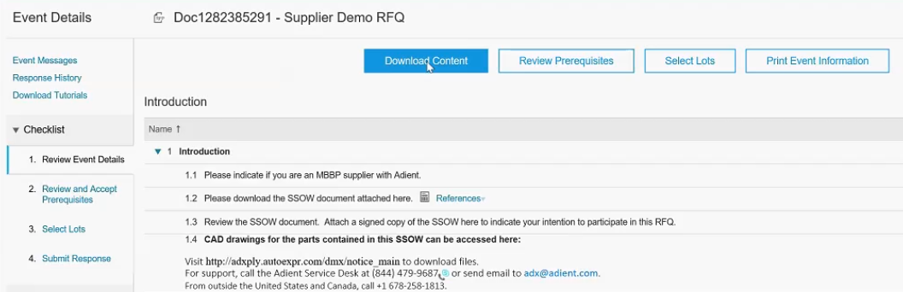
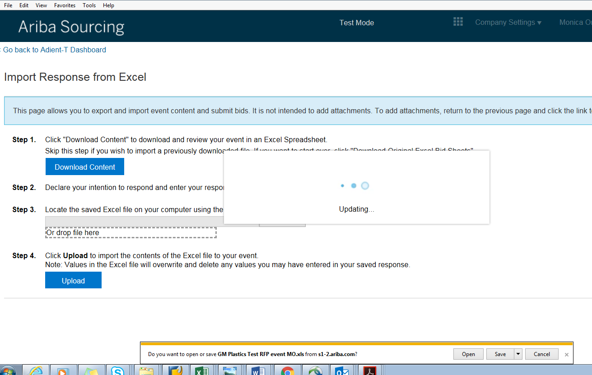
How do you download the event bid form?
Click Download Content to get a copy of the event Bid form the Adient buyer loaded
Open the Excel bid form
Save a copy to your computer to be completed later
Click Done
1
2

Slide 17
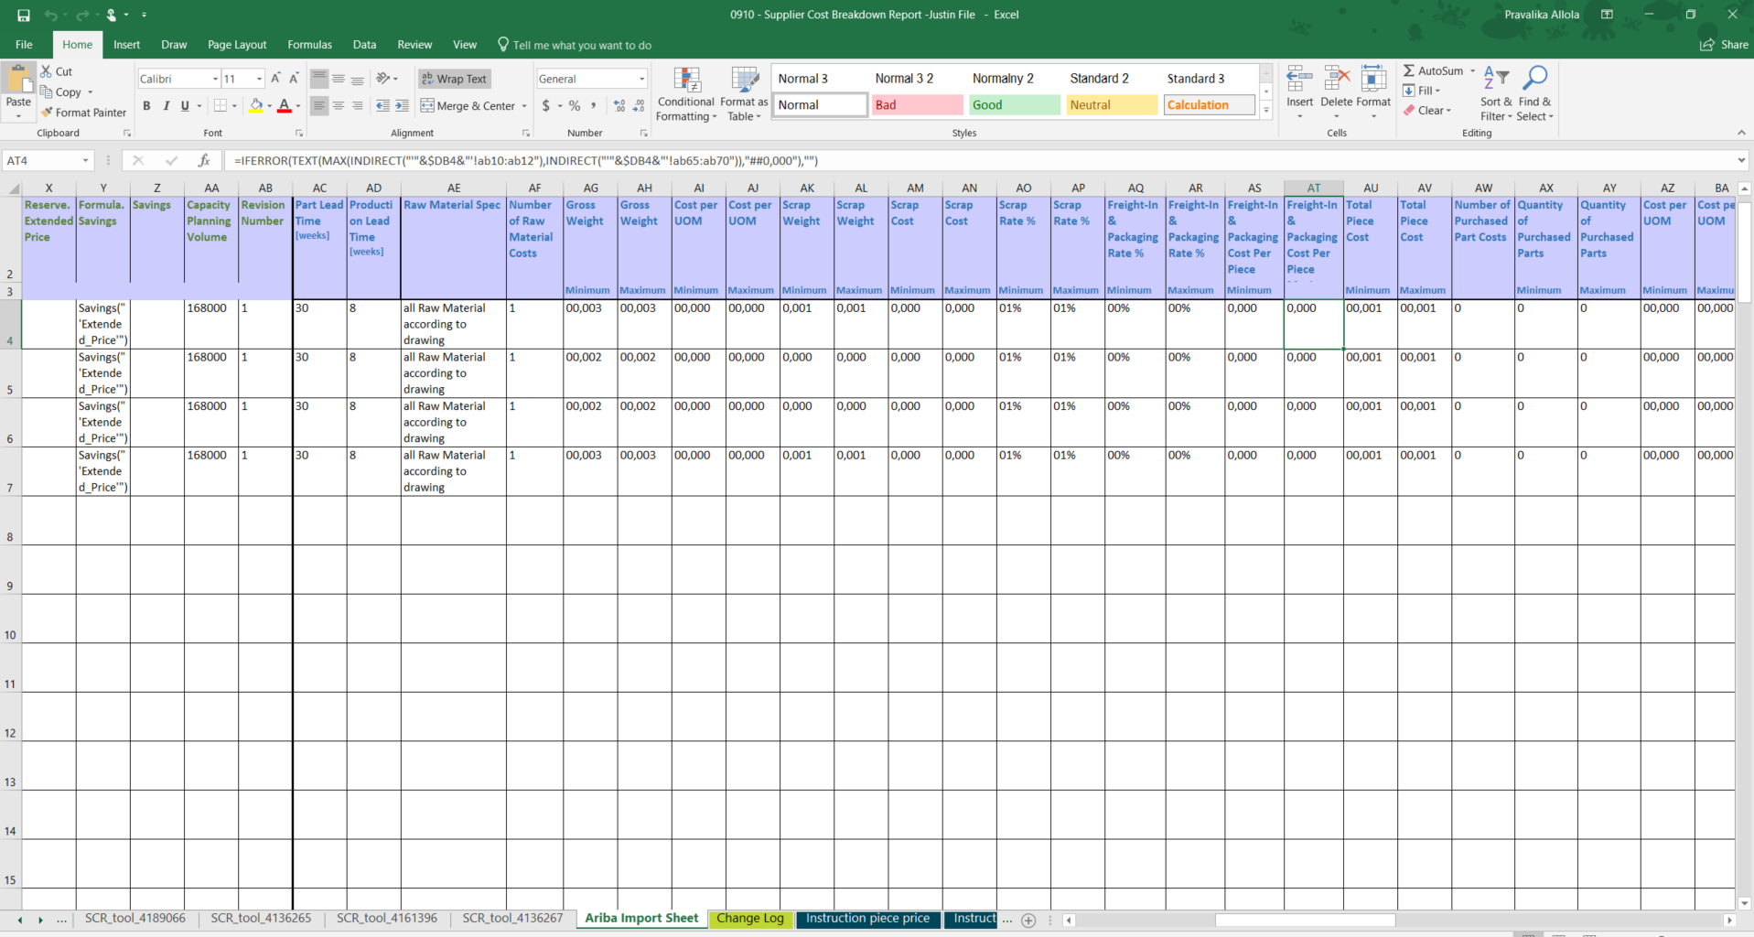
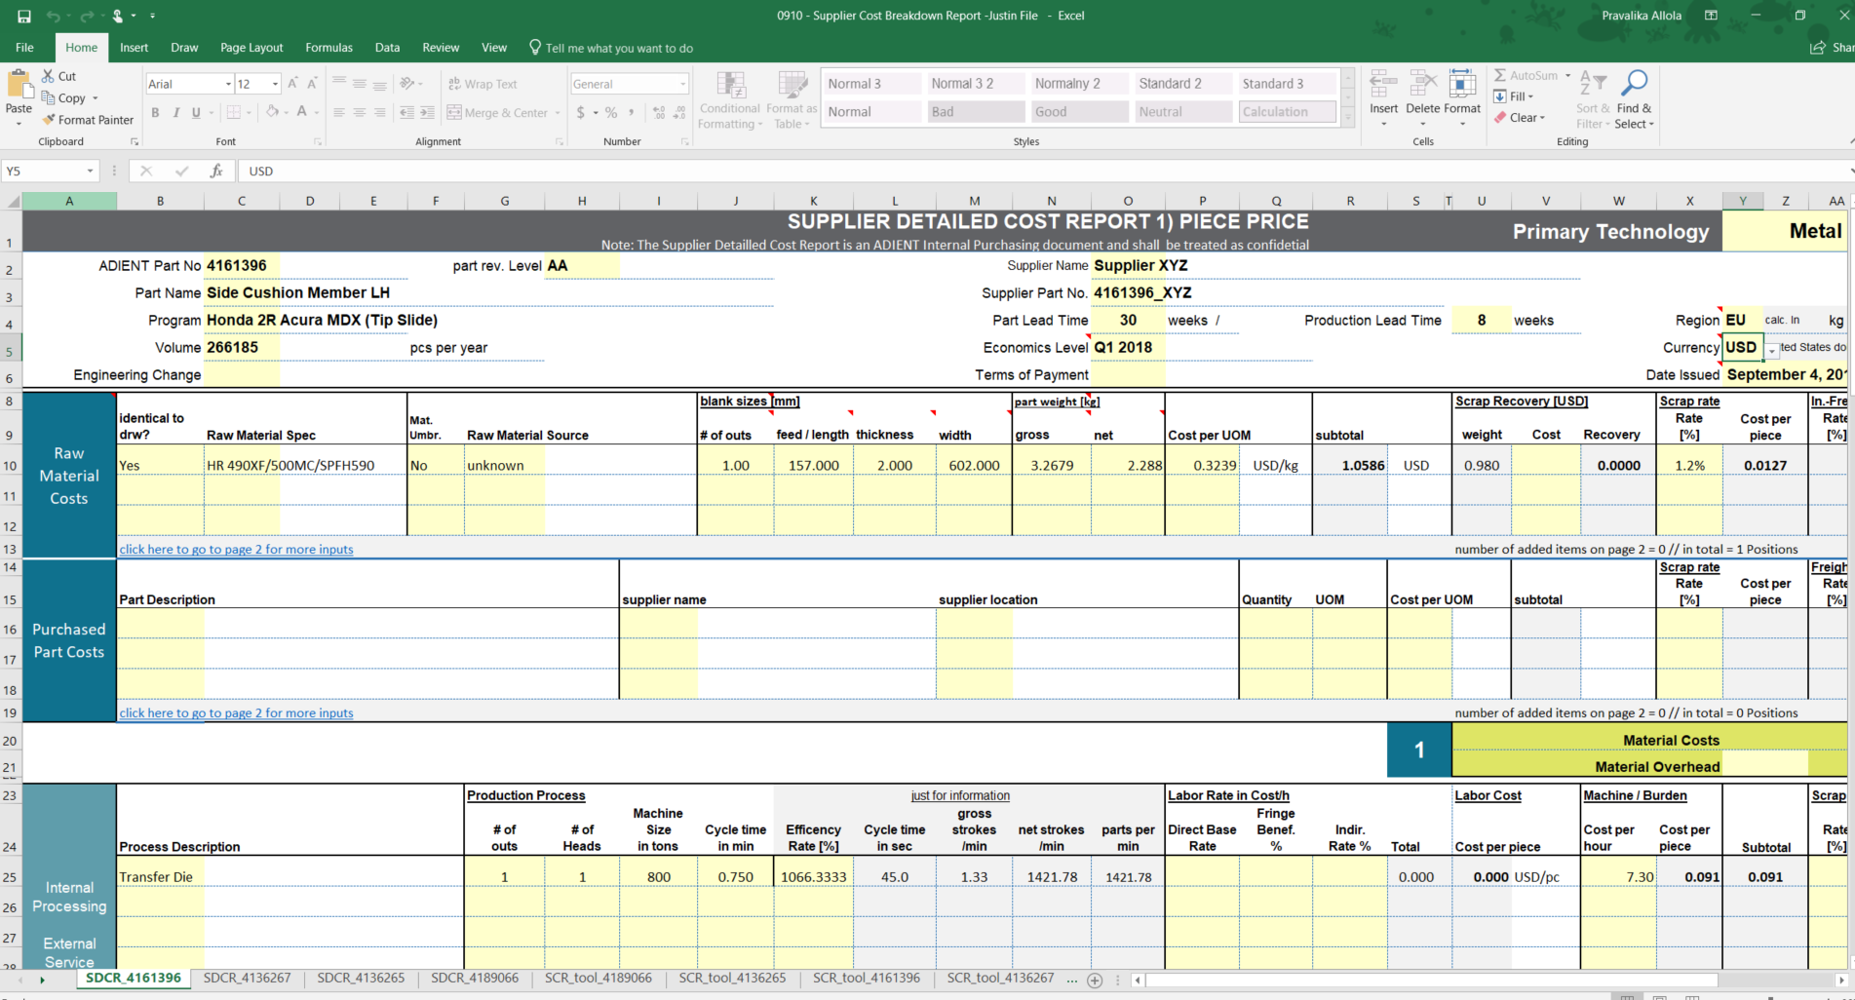
How do you add your pricing data into Ariba?
There are many cost fields to complete for each part or lot in Ariba. To simplify the process, you will use a revised Adient Cost Model sheet.
Fill in Cost break down sheet provided
Check that the new Ariba Import Sheet is automatically filled in based on cost break down data pulled in with formulas
2
Note: Ariba Supplier Import Sheet supports up to 100 lines
1

Slide 18
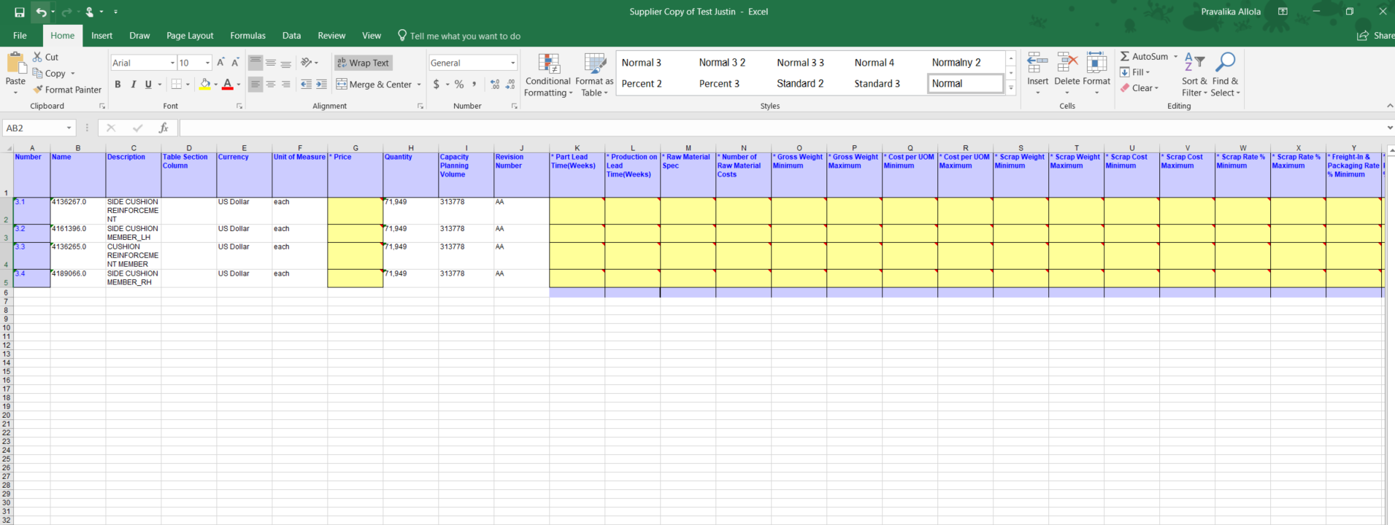
How do you add your pricing data into Ariba? continued
Now, you can simply copy and paste the cost terms from the Ariba Import Sheet into the Pricing sheet within the Bid form you downloaded as an attachment
Ensure that you are only copying the pricing data of the parts you have selected to bid on from the Ariba Import Sheet into the Bid form. Also, double the check the sequence of the parts to ensure that you are copying the right data against the right line item.
Save the completed Bid form to upload next
Important
  Copy cell and Paste values only to retain formulas in Bid form
*The mandatory cost fields, like Price, on the Bid form are highlighted in yellow for you to complete for each part. The white highlighted fields with a border are optional for you to enter data if relevant. The other fields, like Quantity, were completed by the Adient buyer and cannot be edited.

Slide 19
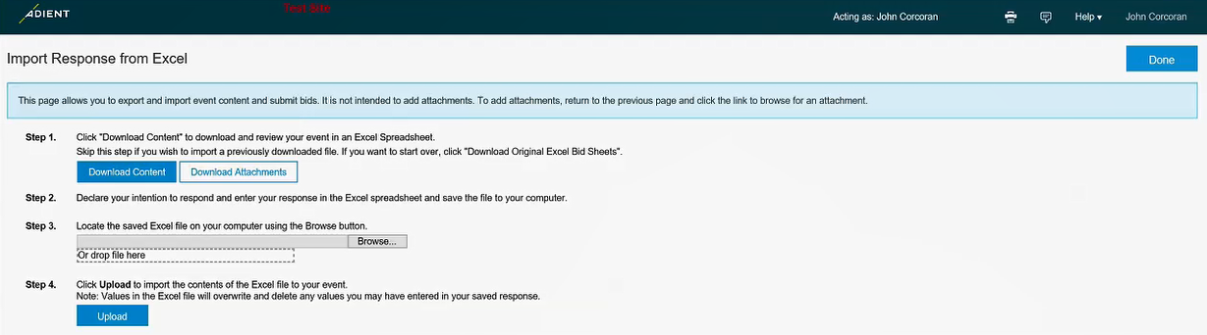
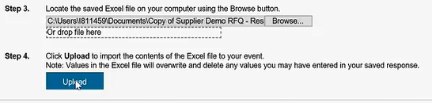
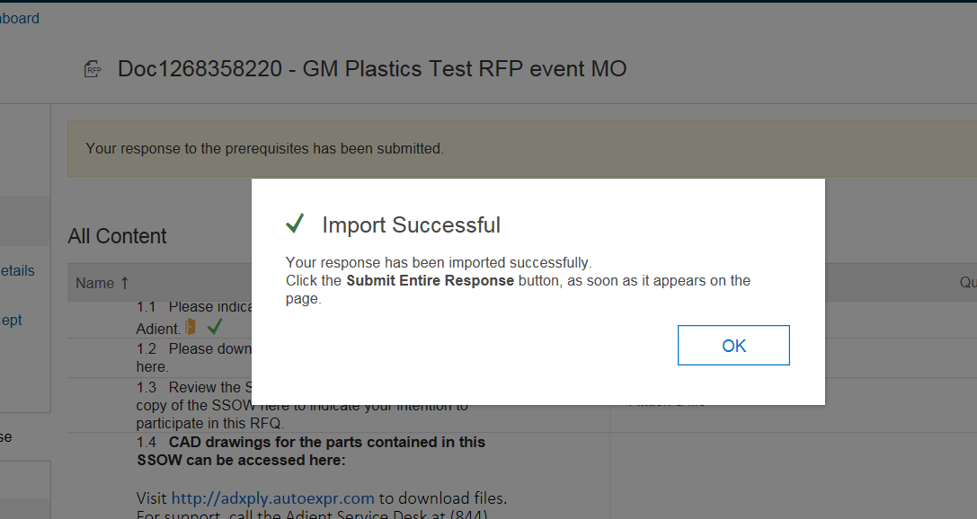
How do you add your pricing data into Ariba? continued
In order to submit your bid into Ariba, you need to:
Click Excel Import button to open the Import Response from Excel window
Browse for your completed Ariba Bid form and select it
Click Upload to import the contents of the Excel file into the event
Receive Import Successful message, click OK
You will be on the 4. Submit Response page

Slide 20
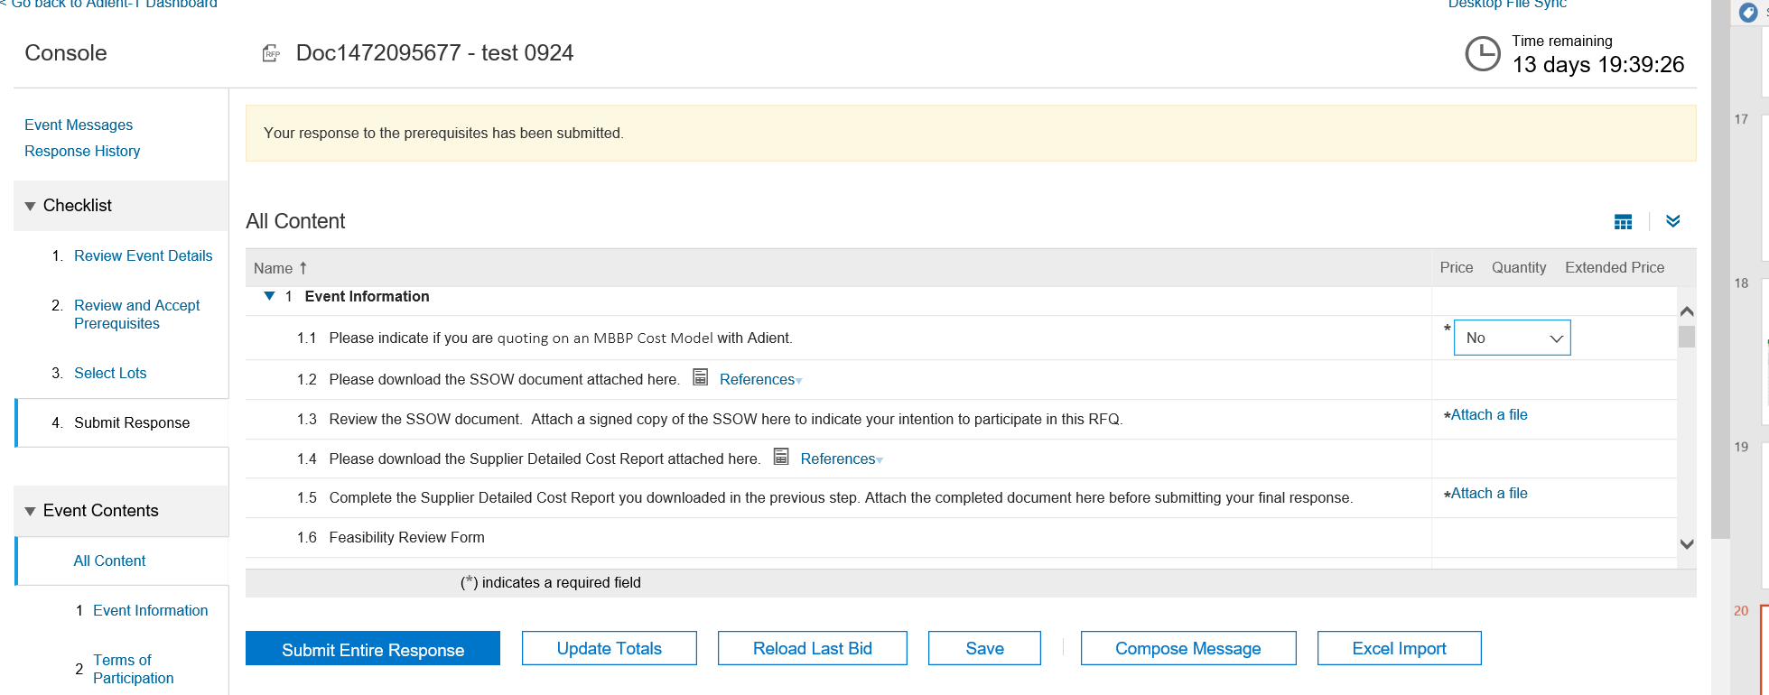
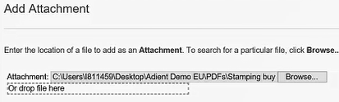
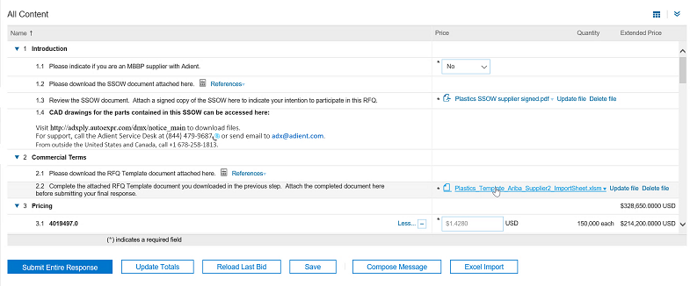
Where do I attach the signed SSOW and Supplier Detailed Cost Report completed cost model?
1
2
Before you can submit your bid response, read the SSOW, sign it, scan it, save it, click Attach a file link, click Browse and select the signed copy. Click OK.
Complete the Supplier Detailed Cost Report, click Attach a file link, and browse for the file, select it. Click OK.

Slide 21
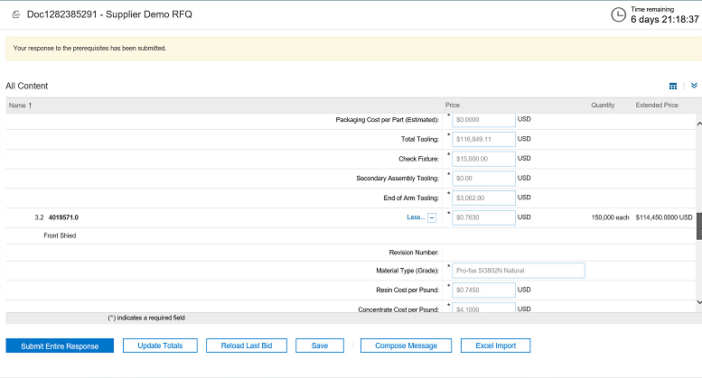

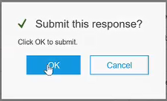
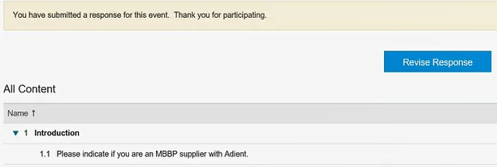
When do you submit your entire bid response?
To submit your bid, click Submit Entire Response button only after you have:
      attached your signed SSOW
      attached your completed Cost Break down sheet
      copied, pasted and imported the summary of your Bid into Ariba
To confirm response, click OK.
You will see a thank you message on top of the screen.
If time is left on the event clock and you need to make a change to your bid, you can press Revise Response, make changes and click Submit Entire Response again.
a
b
c
1
2
3
4

Slide 22
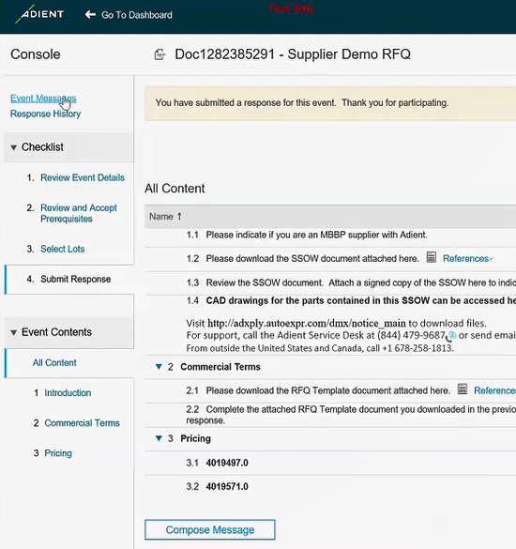
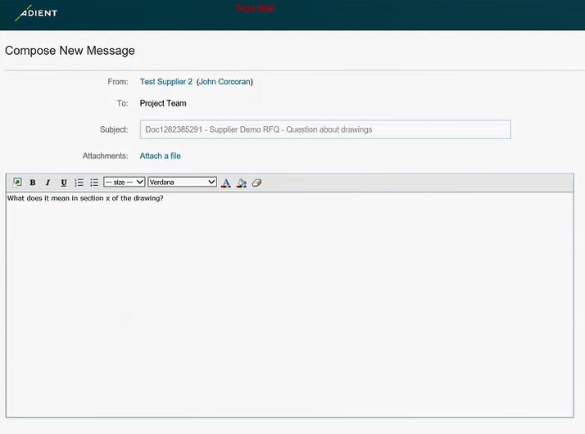
How can you communicate with the Buyer?
Ariba Sourcing allows you to communicate with the buyer by sending and receiving messages from the system. To send a message, click at Compose Message at the bottom of the page. You can read all messages in the Event Messages page.
Ariba will populate your name, the event team, and subject for you. Type your question and click Send.

Slide 23
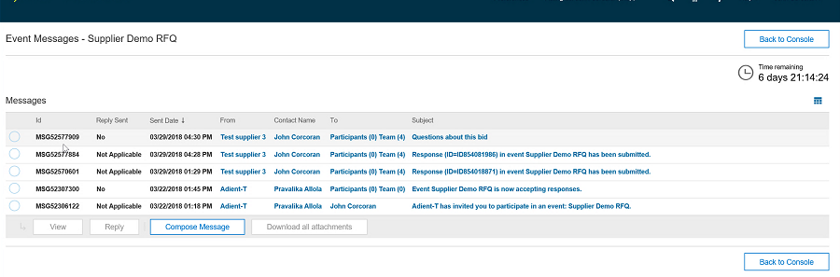
What kind of messages can you expect?
Adient buyers can use Ariba Sourcing to send messages in two forms:
Email (don’t have to be in Ariba)
Pop up messages on the screen (if you are online in Ariba when email is sent)
You can check for buyer requests or questions before, during and after the event.
Can select message to view, reply or download attachment
Can select multiple messages at once to download all attachments
Award notifications can be done within the Ariba system or outside the system.
The event will end at the set designated time where bids will no longer be accepted.
If needed, Adient reserves the right to open the RFQ event again.

Slide 24

Demonstration
(for live training)
Scenario:
Adient RFQ event

Slide 25

Summary
You have completed this guide and should be able to:
    Navigate Ariba Sourcing
    Submit your prerequisites
    Submit your RFQ response to Adient within the Ariba system

Slide 26

What makes the RFQ process in Ariba different?
Adient is consolidating all the activities you do today via Email into the Ariba Sourcing online tool.
  Exchanging the SSOW and returning the signed copy
  Exchanging the Cost Breakdown Sheet and returning the completed bid form
  New difference in importing the summary of the bid, to allow the buyer to have a summarize view of each supplier’s response to assist in making the award decision
  New Event Message center to save all correspondence in one central place and share messages with the event team

Slide 27

For more information and help
Review training and support documentation found on Ariba > Help
Contact Ariba Support
    Go to Help Center and click on the Support link at the bottom of the page. You can reach Ariba support via email/chat/phone. This support is available 24/7.
Contact Adient Support
    Please contact your buyer.

